Slide 1

Phase 2 Project
Beatrice Kariuki - Lead
Rodgers Odhiambo
Mohamed Ali
Ahmed HAJI
Peter Muhia
Emmanuellar Karisa

Slide 2
Predicting House Prices in King County.
The main goal of this project is to create a model that can predict and estimate house prices in King County, Washington, USA, using various property features. The objective is to provide useful information through a comparative market analysis, which can benefit real estate analysts, investors, data scientists, machine learning practitioners, financial institutions, potential home buyers, and prospective tenants, giving them the ability to make informed decisions. The dataset used for this project is the King County House dataset.

Slide 3
Challenges in the Real Estate Industry
1
Runaway Inflation and Interest Rates
2
Intense Competition
The ever-increasing competition in the industry poses challenges in standing out and capturing the attention of potential leads.
The interplay of factors such as runaway inflation, high interest rates, and bank stress is limiting consumer purchasing power, negatively affecting investment earnings in the area.
3
Precise Property Pricing
4
Demographic Shifts
Setting the right price from the beginning is crucial for a property to sell quickly and profitably.
Changes in population characteristics significantly influence demand, preferred locations, and overall market trends.

Slide 4

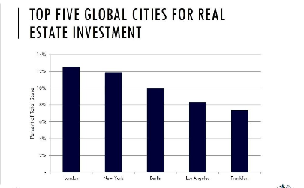

Stakeholders in the Real Estate Industry
Real Estate Analysts
Real Estate Investors
Real Estate Agents
They provide valuable insights and analysis to support decision-making processes.
Individuals or institutions who invest in real estate to generate income.
They facilitate property transactions between buyers and sellers.

Slide 5
Data Understanding
Dataset
Selected Columns
Statistical Summary
King County House Sales dataset with 20 columns and over 21500 records.
Price, bedrooms, bathrooms, sqft living, condition, yr built, sell yr, house age.
Mean house price: USD 540297. No missing values. Standard deviation: USD 367368.

Slide 6
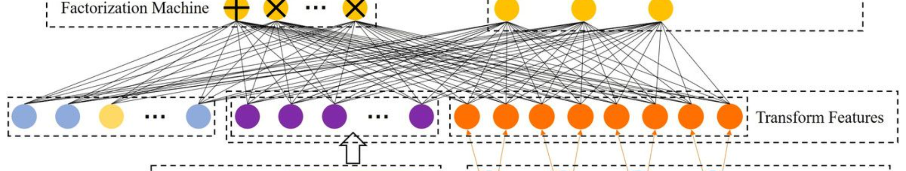
Feature Engineering
1
Date Conversion
2
Categorical Columns
Converting date to datetime format and extracting the year for sell year.
Encoding categorical columns for the linear regression model.

Slide 7
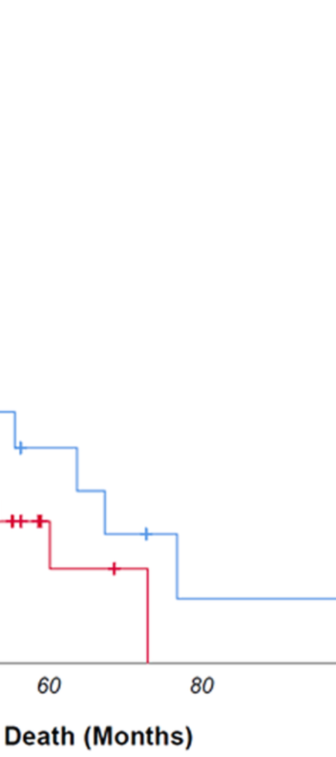
Univariate Analysis
1
Histogram
Shows positively skewed distribution of house prices.
2
Summary Statistics
Provides details on distribution of price and variability around the mean.
3
Box Plot
Confirms the positively skewed distribution of house prices.

Slide 8


Bivariate Analysis
Scatter Plots
Correlation Analysis
Show positive relationship between independent variables and house price.
Examines the relationship between the target variable and other numeric features.

Slide 9
Multivariate Analysis
Heatmap
Visualizes the correlation matrix of features and their relationship to house price.

Slide 10
Modeling
Base Model
Visualization
The simple linear regression model explains 49.3% of the price variation. The coefficient estimates show the relationship between the independent variable and the dependent variable.
Plotting the model fit to assess the linearity of the relationship between the house price and the square footage of living space.

Slide 11
Analyzing the Models
Simple Linear Regression
Multiple Linear Regression
The relationship between the independent variable (sqft_living) and the dependent variable (price) is statistically significant with an R-squared of 0.493.
Utilizing multiple features to predict house prices resulted in a statistically significant model with an R-squared of 0.465.

Slide 12
Modeling
Multiple Linear Regression
2
Model Evaluation
1
Model Results
Model 2 with multiple features has the highest R-squared value of 46.5%, indicating that it explains a larger proportion of the variance in the dependent variable compared to the other model.
The model's root mean squared error (RMSE) of approximately USD 253518.9 highlights the model's average prediction deviation from the actual prices.

Slide 13
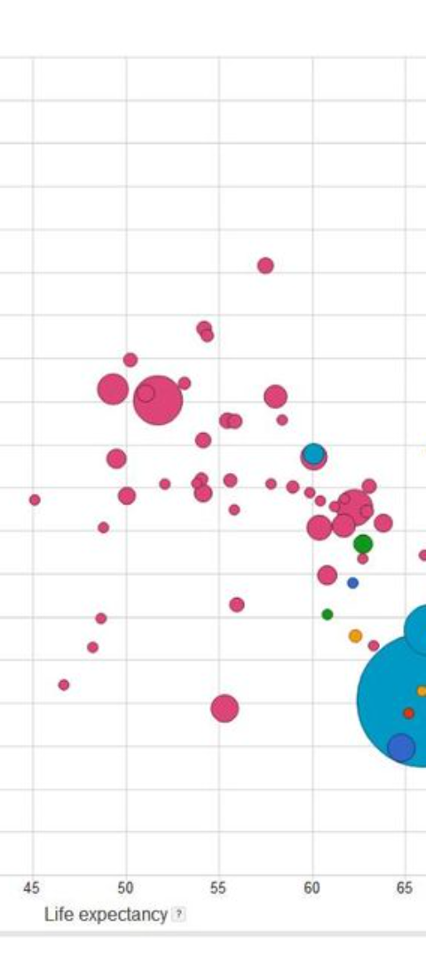


Visualizing the Regression Line
Simple Linear Regression
The plot helps assess the linearity of the relationship between house price and living space.
Multiple Linear Regression
The visualization depicts the correlation between various predictors and housing prices.

Slide 14
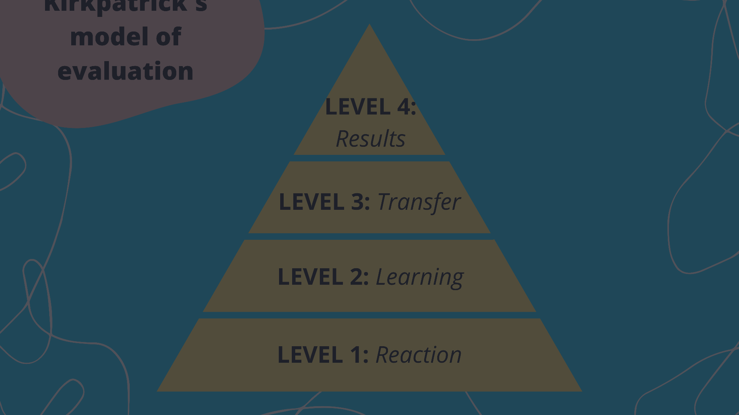
Model Evaluation
Model 1
Model 2
Final Model Evaluation
MAE: 0, RMSE: 0.4
MAE: 0, RMSE: 0.3
The final model shows a Prob (F-statistic) of 0.000, indicating its statistical significance with an R-squared of 0.465.

Slide 15

Benefits of Informed Decisions
1
Data-Driven Strategy
Accessible comparative market analysis supports informed decisions and increases the likelihood of successful transactions.
2
Efficient Investment
Having accurate pricing information helps investors make efficient and profitable real estate investment decisions.
3
Enhanced Market Knowledge
Accessing data on property features and trends provides comprehensive market knowledge for all stakeholders.

Slide 16

Next Steps and Recommendations
1
Strategic Pricing
2
Continuous Analysis
Implement a precise pricing strategy based on data and market knowledge to ensure competitive advantage.
Regularly analyze market trends and data to adapt strategies and stay ahead in a dynamic real estate landscape.
3
Client-Centric Approach
Focus on providing personalized services tailored to the needs and preferences of potential buyers and tenants.

Slide 17
Conclusions
Runaway Inflation
Competition
High interest rates, bank stress, and tightening liquidity are impacting investment earnings in the area.
Standing out and capturing the attention of potential leads can be a challenging endeavor due to increasing competition.
Pricing Properties
Demographics
Setting the right price for a property is crucial for a quick and profitable sale.
Change in demographics can significantly impact the real estate industry, influencing demand and market trends.

Slide 18
THANK YOU

